Slide 1
Installing and Upgrading Client Systems
Lesson 1

Slide 2
Objectives
Skill/Concept | Exam Objective | Objective Number
Understanding Windows Systems | Identify Windows operating system editions Understand operating system architecture | 2.1 2.4
Understanding Installation Types | Identify upgrade paths Understand installation types | 2.2 2.3

Slide 3
Understanding Windows Systems (1/2)
The client version of Windows is the version that is purchased and installed on personal computers such as desktop computers, laptops, workstations, and tablets.
Windows Server operating systems are purchased and installed on stand-alone physical servers, blade servers, and virtual machines.

Slide 4
Understanding Windows Systems (2/2)
Windows 10 is the newest client operating system.
To distance Windows 10 from Windows 8/8.1, Microsoft skipped Windows 9 and went to Windows 10.
Unlike previous versions of windows, Windows 10 is an “operating system as a service,” meaning it receives ongoing updates to features and functionality.

Slide 5
Client and Server Operating Systems
Client Operating Systems | Server Operating Systems | Version Number
Windows 10 | Windows Server 2016 | 10.0
Windows 8.1 | Windows Server 2012 R2 | 6.3
Windows 8 | Windows Server 2012 | 6.2
Windows 7 | Windows Server 2008 R2 | 6.1
Windows Vista | Windows Server 2008 | 6.0
Windows XP | Windows Server 2003/Windows Server 2003 R2 | 5.1/5.2
Windows 2000 Professional | Windows 2000 Server | 5.0
Windows NT 4.0 Workstation | Windows NT 4.0 Server | 4.0

Slide 6
Understanding User Interfaces (UIs) (1/2)
A user interface (UI) is the part of the operating system, program, or device that users use to input and receive data, and to tell the computer what to do. For example, to play a video, navigate to the folder where the video file is located, and double-click the file. Windows typically identifies the program, opens a video player, and plays the file.

Slide 7
Understanding User Interfaces (UIs) (2/2)
There are two types of user interfaces:
Graphical user interface (GUI): The user performs actions by clicking and moving buttons, icons, and menus with a pointing device, such as a mouse or track pad.
Text user interface (TUI)/command-line interface (CLI): The user performs actions by using a keyboard to enter commands.

Slide 8
Determining Appropriate Editions to Use
Like previous client version operating systems, Windows 10 offers multiple editions.
The barest version is Windows 10 Home, which is the least expensive and has the fewest number of features.
Windows 10 Pro includes more features and Windows 10 Enterprise (the most expensive edition) and Windows 10 Education include the most features.

Slide 9
Understanding Processor & Memory Architecture
The Windows processor runs in two modes:
  The kernel mode has complete and unrestricted access to the underlying hardware.
  The user mode does not have direct access to the hardware or reference memory.
Windows runs on a desktop computer that has a processor based on the x86 (32-bit) or x64 (64-bit) architecture.

Slide 10
32-bit and 64-bit Computing (1/2)
32-bit and 64-bit refer to the way a computer's central processing unit (CPU) processes data.
64-bit computer can use more random access memory (RAM) than 32-bit computer.
Operating systems come in 32-bit and 64-bit versions.
  Must match the correct operating system to the computer processor

Slide 11
32-bit and 64-bit Computing (2/2)
Enterprise environment with mix of 32-bit and 64-bit systems needs:
  Both types of drivers for networked printers, scanners, projectors, and other shared devices
  Multiple images—at least one image for the 32-bit computers and one for the 64-bit computers

Slide 12
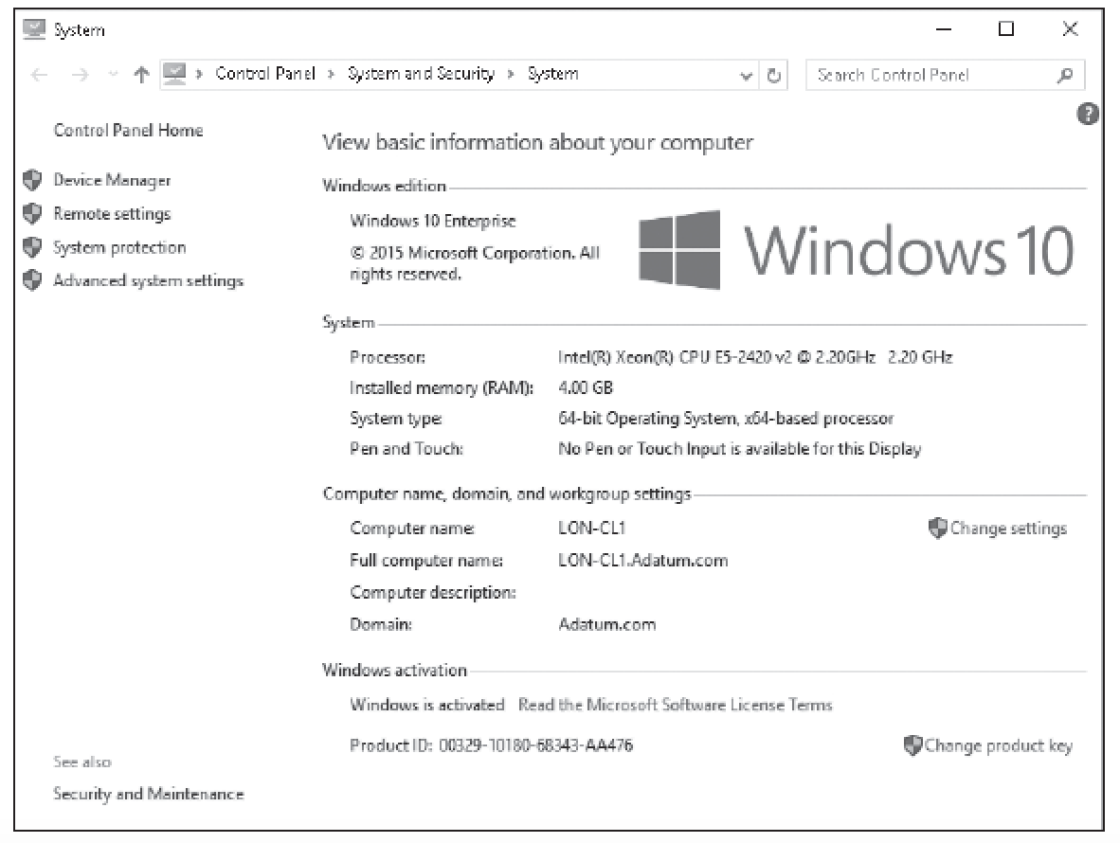
Viewing System Information

Slide 13
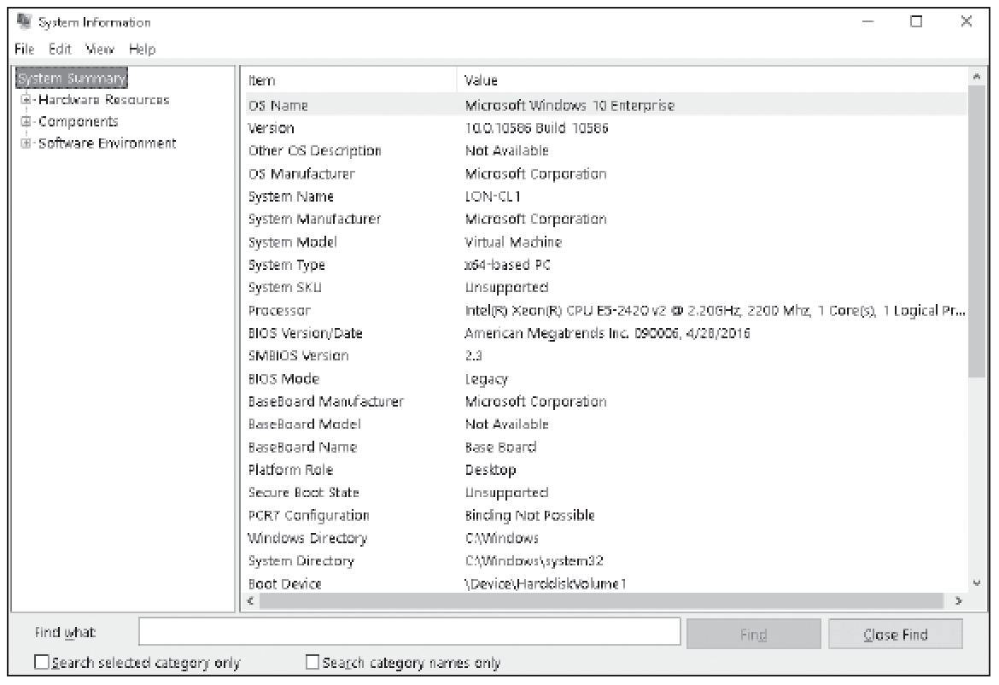
Viewing System Type Value

Slide 14
Understanding Drivers
A computer is a collection of hardware devices, each of which requires a piece of software called a device driver in order to function.
Windows 10 includes a large library of device drivers, but it is still sometimes necessary to obtain them yourself.

Slide 15
Windows 10 System Requirements
Processor: 1 gigahertz (GHz) or faster
RAM: 1 gigabyte (GB) for 32-bit or 2 GB for 64-bit
Hard disk space: 16 GB for 32-bit OS or
20 GB for 64-bit OS
Graphics card: DirectX 9 or later with WDDM 1.0 driver
Display: 800 × 600

Slide 16
Understanding Installation Types (1/3)
There are several types of Windows 10 installations, from the manual DVD method to a fully automated setup over a network.
Learn the various ways in which you can install Windows 10 and select the most efficient method for your needs.

Slide 17
Understanding Installation Types (2/3)
The following categories correspond to the level of interaction required:
  High Touch Installation (HTI) may include retail media or a standard image (ISO file).
  Lite Touch Installation (LTI) requires some human intervention in the early phase of the installation but is automated (or unattended) from that point on. It works well in environments with more than 150 computers.

Slide 18
Understanding Installation Types (3/3)
Zero Touch Installation (ZTI) is a fully automated, “touchless” method of installing Windows. You need System Center Configuration Manager (SCCM) for ZTIs. You use SCCM to deploy and update servers, client computers, and all kinds of devices on a network.

Slide 19
Performing a Clean Install of Windows 10
The simplest way is to boot from a bootable Windows 10 installation disk or USB drive, which will start the setup program.
You can also search for and find the Windows 10 Media Creation tool, which can be used to create a copy of your Windows 10 ISO file on a USB flash drive or DVD.
You can then use the USB flash drive to install Windows 10.

Slide 20
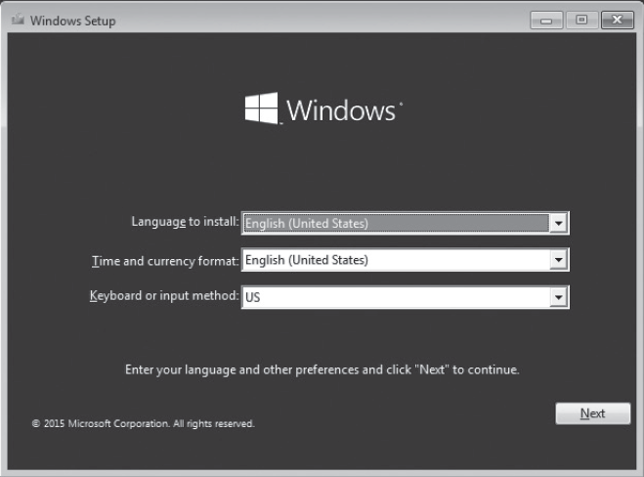
The Windows Setup Page

Slide 21
Upgrading to Windows 10
If you need to upgrade from Windows 7 or Windows 8/8.1 to Windows 10, you can use a Windows 10 bootable DVD or bootable USB drive.
You can also upgrade Windows 10 by using the Windows 10 Media Creation tool.

Slide 22
Migrating to Windows 10 (1/3)
Sometimes, you might want to move a user from one system to another, including moving a user from a computer running Windows 7 or Windows 8/8.1 to a computer running Windows 10.
One of the most time-consuming tasks is to move user files and settings between computers and operating systems.

Slide 23
Migrating to Windows 10 (2/3)
The User State Migration Tool (USMT) is a command-line tool that migrates user data from a previous installation of Windows to a new installation of Windows.
It provides you with the ability to customize the user-profile migration experience.

Slide 24
Migrating to Windows 10 (3/3)
When you use USMT, you should use the following three-step process:
Plan the migration.
Collect the files and settings from the source computer.
Prepare the destination computer and restore the files and settings.

Slide 25
Summary (1/4)
Windows 10 is the newest client operating system. Unlike previous versions of Windows, Windows 10 is an “operating system as a service,” which means it receives ongoing updates to its features and functionality.
Windows 10 supports two platforms: IA-32 and X86-64.
IA-32 is designed to run on systems with the 32-bit x86 processors.
IA-32 can only access up to 4 GB of memory.

Slide 26
Summary (2/4)
X86-64 is designed to run on the x86-64 processors.
Windows 10 can support up to 128 GB of memory, while the other desktop editions can support up to 2048 GB of memory.
A clean installation of Windows is when you install Windows where there is no operating system, data, or programs stored on the hard drive, or you perform the installation of Windows while reformatting the current hard drive, so that you are installing Windows on an empty hard drive.

Slide 27
Summary (3/4)
An upgrade installation of Windows is when you have
a system that is running Windows 7 or Windows 8/8.1
and you run the Windows installation program, replacing
the Windows 7 or Windows 8/8.1 operating system with Windows 10.
You can upgrade from Windows 7 or Windows 8/8.1 to like versions of Windows 10.

Slide 28
Summary (4/4)
The User State Migration Tool (USMT) is a command-line
tool that migrates user data from a previous installation of Windows to a new installation of Windows.
Installation methods fall into three main categories: High Touch Installation (HTI), Lite Touch Installation (LTI), and Zero Touch Installation (ZTI). HTI is mostly manual, and ZTI is almost completely automated.

